Slide 1
Organizational Development
SE495: Software Entrepreneurship

Slide 2

Organizational Development
Organizational Development is the process of improving the efficiency, effectiveness, and overall performance of an organization.
In the context of software startups, it plays a crucial role in their ability to scale and succeed.

Slide 3
Organizational Development Importance
Alignment of goals and objectives
Structured processes and systems
Talent acquisition and retention
Communication and collaboration
Adaptability and flexibility
Leadership development
Learning and continuous improvement

Slide 4
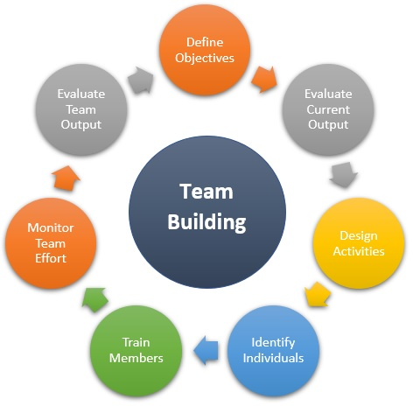
Team Building and Management
Building a strong team
Diverse skill sets
Collaboration and synergy
Motivation and morale
Effective communication
Adaptability and resilience
Talent attraction and retention
Innovation and creativity

Slide 5
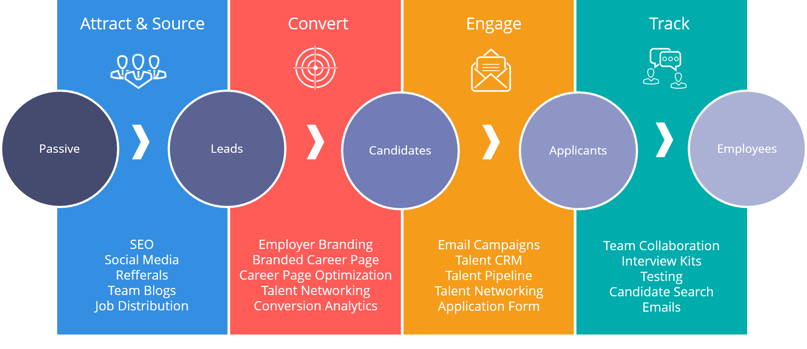
Hiring Process

Slide 6
Hiring Process
Define job roles
Source candidates
Screen and shortlist resumes
Conduct interviews
Assess skills and cultural fit
Check references
Make job offers

Slide 7
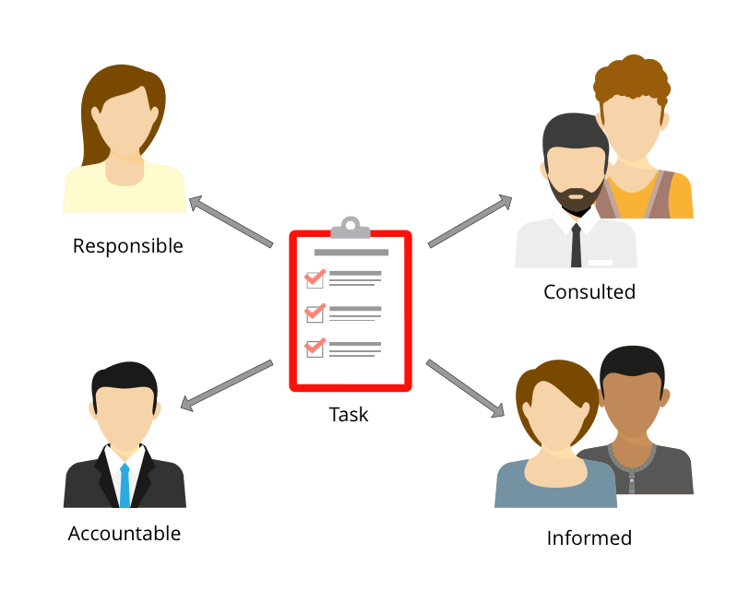
Roles and Responsibilities
Founder's role:
Setting the vision
Strategy development
Culture creation

Slide 8
Roles and Responsibilities
Team members' roles:
Defining clear roles
Collaboration and teamwork
Task execution
Continuous learning and improvement
Communication and transparency
Problem-solving and decision-making

Slide 9
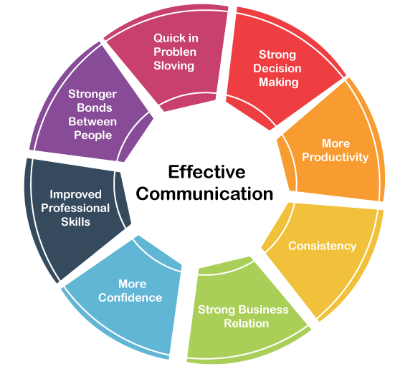
Effective Communication
Clear communication channels:
Weekly meetings
Email
Project management tools

Slide 10
Effective Communication
Active listening:
Provide a safe and open environment
Practice empathy
Repeat and summarize
Ask for clarification

Slide 11

Conflict Resolution
Conflict management is a crucial skill for startup teams to maintain a healthy and productive work environment.
Here are some approaches and techniques that can be used to address conflicts promptly and effectively:
Address conflicts promptly
Active listening and empathy
Mediation
Problem-solving and collaboration
Compromise and negotiation
Establish clear guidelines and policies
Learn from conflicts

Slide 12
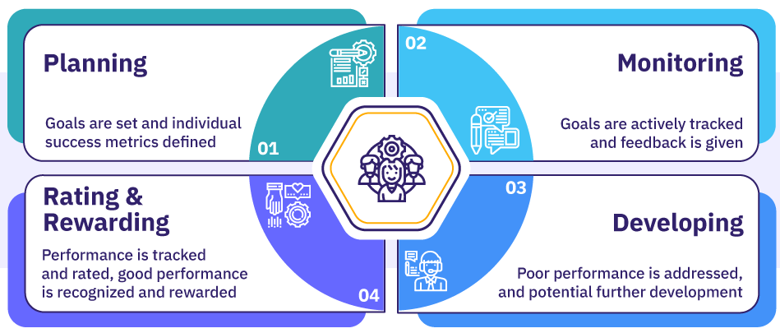
Performance Management
Setting goals and expectations:
Clear and measurable goals
Individualized goals
Regular goal review and alignment

Slide 13
Performance Management
Regular feedback:
Ongoing feedback
Constructive feedback
Recognition and rewards

Slide 14
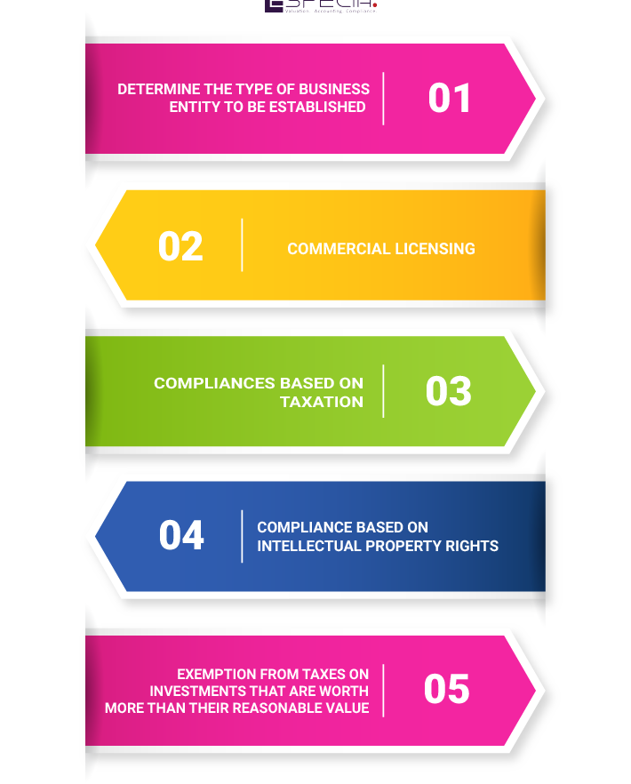
Legal Considerations
Protecting intellectual property (IP) is crucial for startups to safeguard their innovations and creations.
Two important aspects related to IP protection and incorporation:
Protecting IP:
Non-disclosure agreements (NDAs)
Copyrights
Patents
Incorporation:
Registering as a legal entity
Tax benefits

Slide 15
Accounting Basics
Financial statements:
Balance sheets
Income statements
Cash flow statements

Slide 16
Accounting Basics
Accounting methods:
Cash basis accounting
Accrual basis accounting

Slide 17
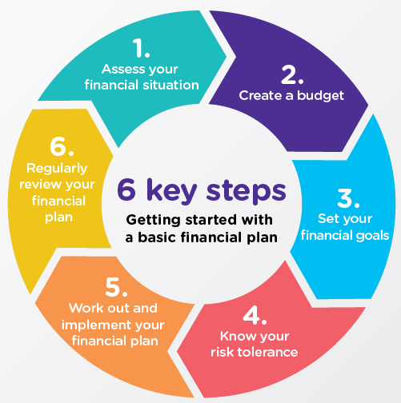
Financial Planning
Budgeting
Creating a comprehensive budget to manage expenses and forecast revenue.
Cash flow management
Ensuring sufficient cash reserves for operations and growth.

Slide 18

Fundraising
Bootstrapping
Financing the startup through personal savings, revenue, and cost-cutting measures.
Angel/seed investors
Pitching to angel investors or seed-stage venture capitalists for funding.

Slide 19

Financial Management
Financial forecasting
Creating realistic revenue and expense projections.
Cost control
Monitoring and controlling expenses to optimize profitability.

Slide 20
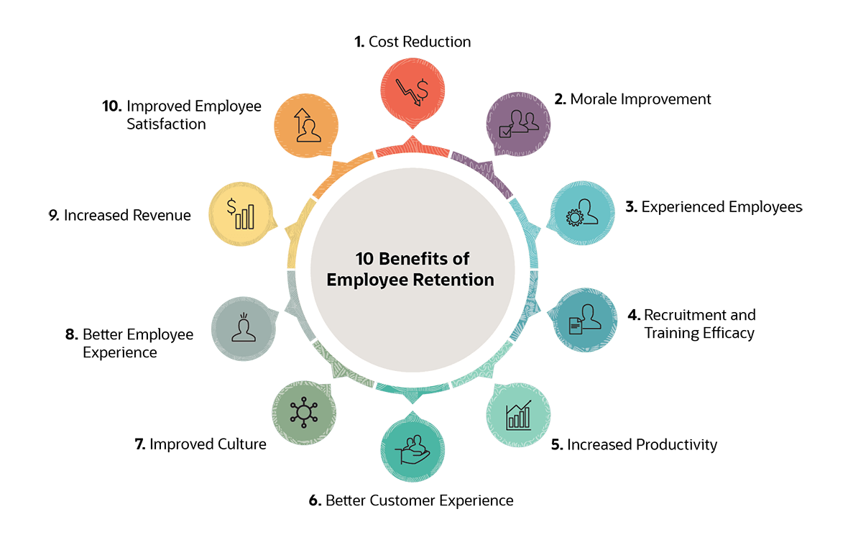
Retention and Motivation
Employee retention
Implementing strategies to retain top performers (e.g., equity, bonuses).
Motivation
Creating a motivating work environment through recognition, rewards, and opportunities for growth.

Slide 21
Case Study: GitHub

Slide 22

Background
GitHub was founded in 2008 and quickly became the go-to platform for software developers to collaborate and share code.
The company grew rapidly, and by 2015, it had over 100 employees.
However, as the company grew, the founders realized that their flat organizational structure and lack of formal processes were causing problems.

Slide 23
Issues
Lack of Clear Communication:
GitHub's flat structure meant that there were no clear channels for communication, and employees often had to rely on informal networks to get information.
Inefficient Decision-Making Process:
GitHub's decision-making process was slow and inefficient.
Inadequate Performance Management:
GitHub had a lack of effective performance management.
Poor Employee Engagement:
GitHub had a high turnover rate, and employees often reported feeling disengaged and unvalued.

Slide 24
Solution
GitHub implemented several organizational development initiatives.
Establishing a clear communication channel that included regular town hall meetings, departmental meetings, and one-on-one check-ins between managers and employees.
Developing a performance management system that included regular feedback and evaluations.
GitHub focused on building a positive company culture.
GitHub established a clear career development path for employees, providing opportunities for growth and advancement within the company.

Slide 25
Results
After implementing these organizational development initiatives, GitHub saw a significant improvement in their operations and culture.
Communication improved, decision-making became more efficient, and employee engagement and retention increased.
The company was able to respond more quickly to changing market conditions, and productivity and morale improved.
In 2018, Microsoft acquired GitHub for $7.5 billion, a testament to the company's success in addressing its organizational development challenges.

Slide 26
Conclusion
GitHub's experience highlights the importance of organizational development in supporting the growth and success of a tech startup.
By addressing issues such as communication, decision-making, performance management, employee engagement, and career development, tech startups can create a strong foundation for growth and success.

